Slide 1
Hadoop File System and Python HDFS Clone
Thomas Cannon and Roshan Mathi

Slide 2
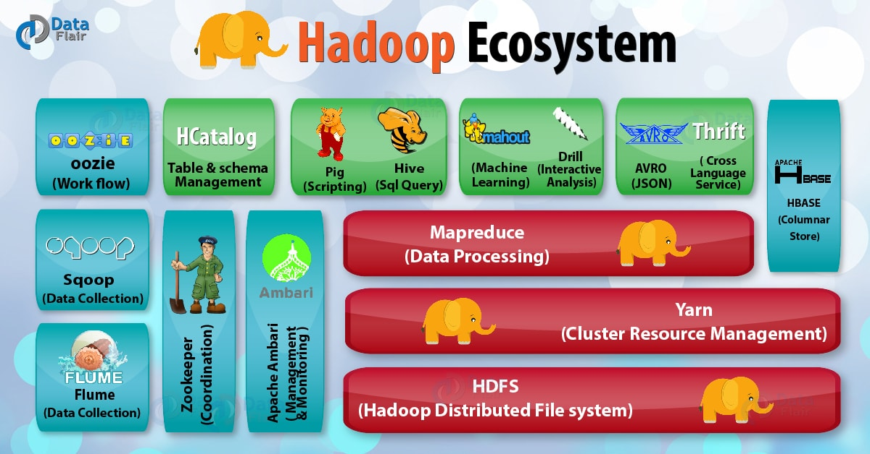
Hadoop

Slide 3

Hadoop File System

Slide 4
Commodity Hardware
Cheap hardware often bought at wholesale and strung together to make servers
Pros:
Inexpensive
Cons:
Unreliable

Slide 5
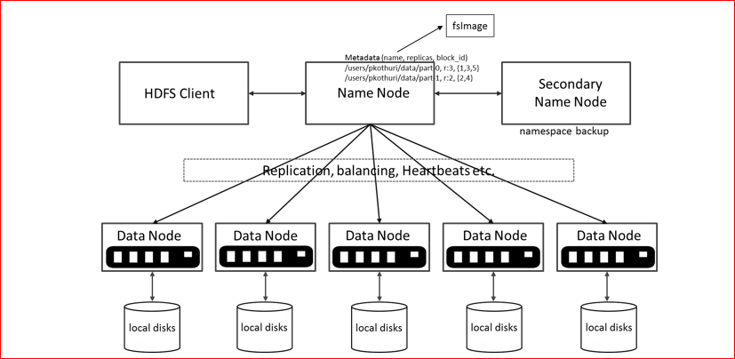
Hadoop File System

Slide 6
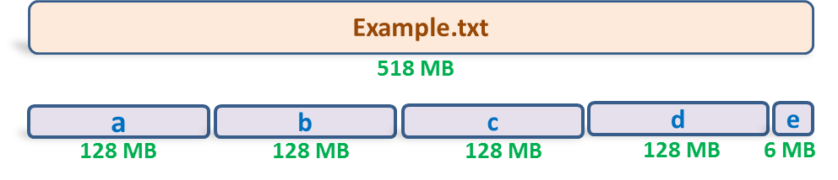
File <Example.txt> split into 5 blocks

Slide 7
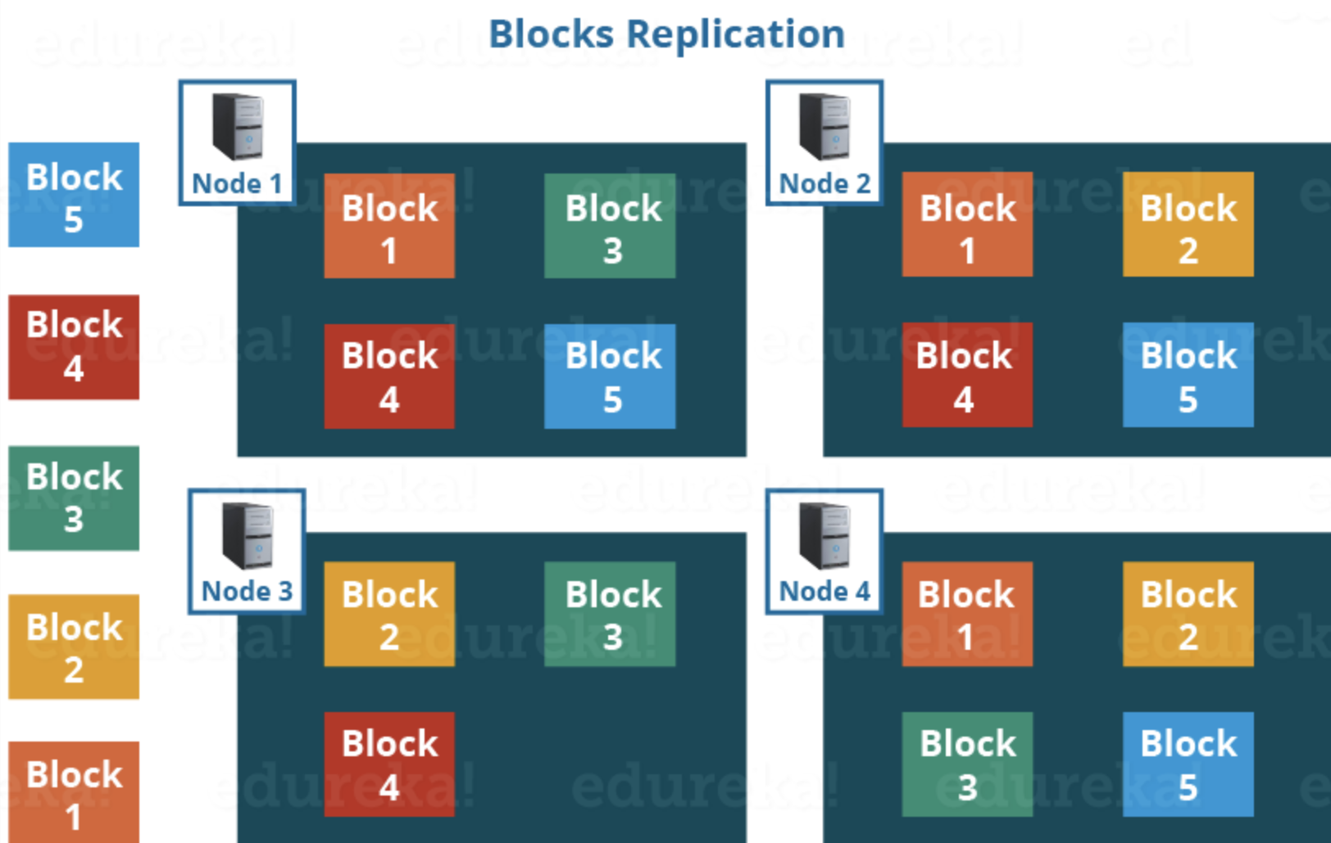
Hadoop Performance Analysis

Slide 8
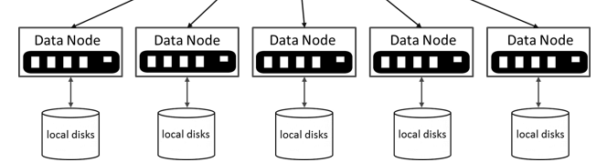
Data Node
Runs on Commodity Hardware
Store Data in the Cluster as blocks
Send heartbeats at regular intervals to NameNode
Perform small read/write requests made by the client

Slide 9
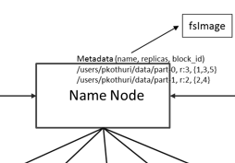
Name Node
Receive Heartbeat Data and Block Reports
Check if all data follows replication factor pattern
Record pertinent cluster metadata
Important Files
FsImage - record file system namespace
EditLogs - file system changes

Slide 10
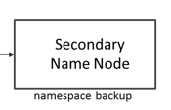
Secondary Name Node
Write data from the NameNode's RAM into the Hard Drive
Synthesize information from the EditLogs with the FsImage

Slide 11
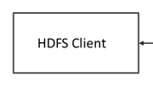
Client
User interface that interacts with the Hadoop File System
The general HDFS Client is:
hdfs dfs

Slide 12
Hadoop File System

Slide 13
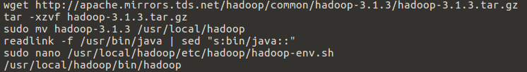
Installing Hadoop

Slide 14
Citations
https://data-flair.training/blogs/hadoop-ecosystem-components/
https://hadoop.apache.org/docs/r1.2.1/hdfs_design.html
https://blog.eduonix.com/bigdata-and-hadoop/learn-hadoop-distributed-file-system-management/
https://data-flair.training/blogs/data-block/
https://www.quora.com/How-is-replication-done-in-Hadoop

Slide 15
Python HDFS Clone
Thomas Cannon and Roshan Mathi

Slide 16
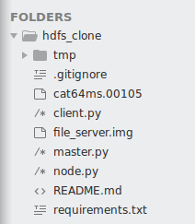
Project Overview
Master Script
activates the machine as a master node on a specified port
divides up the file to be sent to the data nodes or reassembles the file after it has been retrieved from the data nodes
Node Script
opens a port on the machine to receive commands and data packets from the master node
contains the logic to store and retrieve the file blocks locally and send them back to the master node
Client Script
acts as the client through a terminal interface

Slide 17
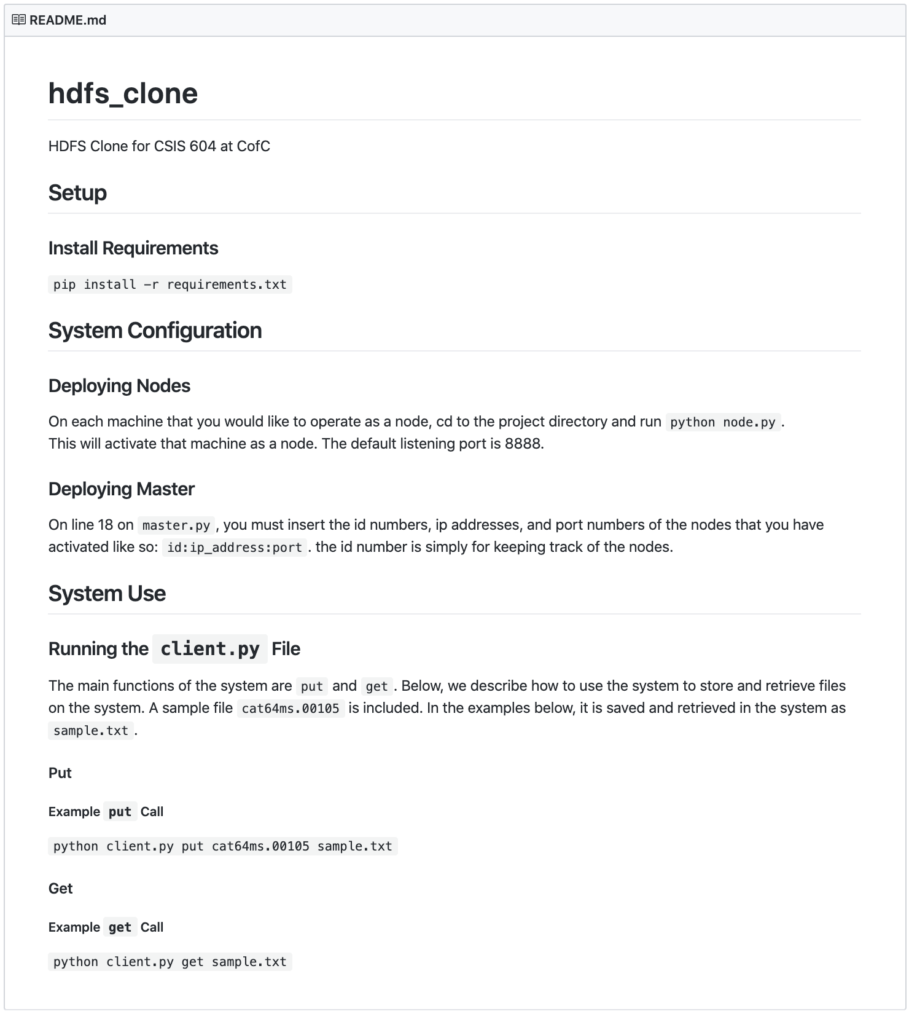
Documentation: Design

Slide 18
Documentation: Usage

Slide 19
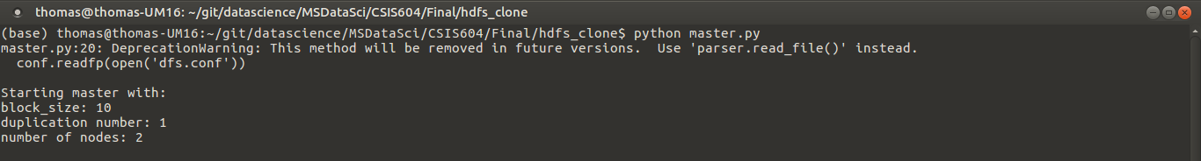
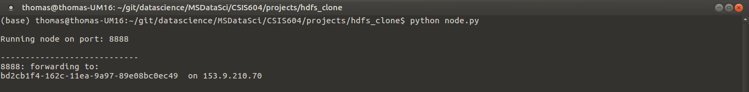
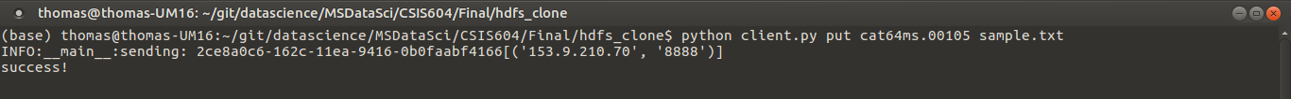
Example Usage
Master
Node
Client

